Slide 1
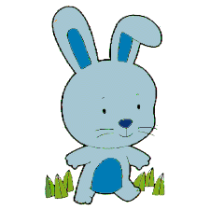
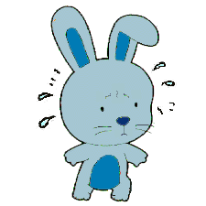
This is Bunny.
Bunny is worried because tomorrow s/he has to give show-and-tell.
Show-and-tell makes bunny worried.

Slide 2
In the morning, Bunny thinks about show-and-tell, and so Bunny feels worried.

Slide 3
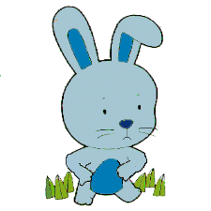
Bunny wonders whether s/he will have a tummy ache from being so worried. S/he thinks about whether s/he will have a tummy ache or whether s/he will not have a tummy ache later today.

Slide 4
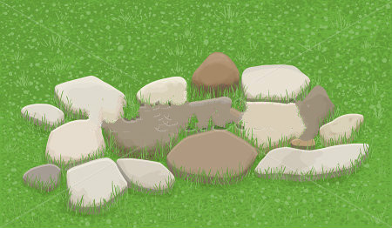
In the afternoon, Bunny runs very fast on the hard rocks.

Slide 5
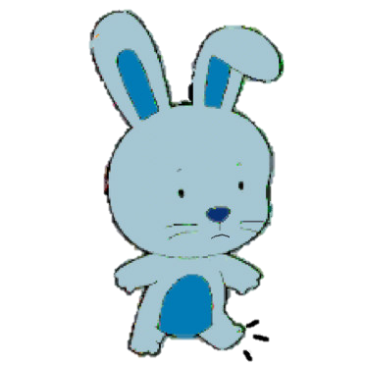
Bunny wonders whether s/he will have sore foot from running so fast on the hard rocks. S/he thinks about whether s/he will have sore foot or whether s/he will not have sore foot later today.

Slide 6
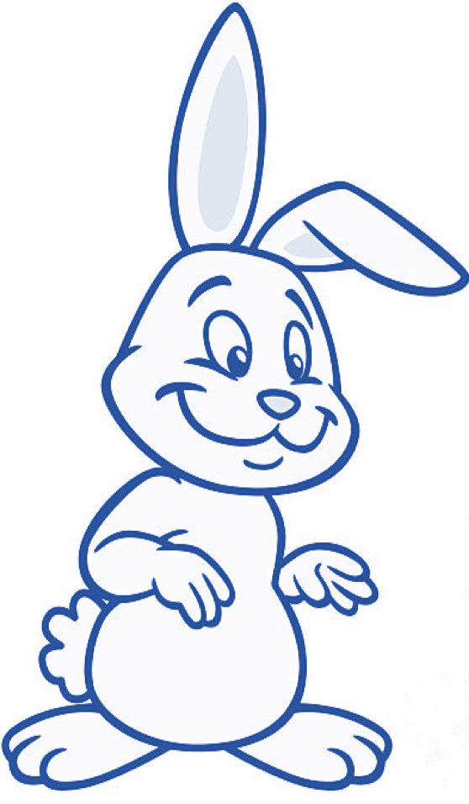
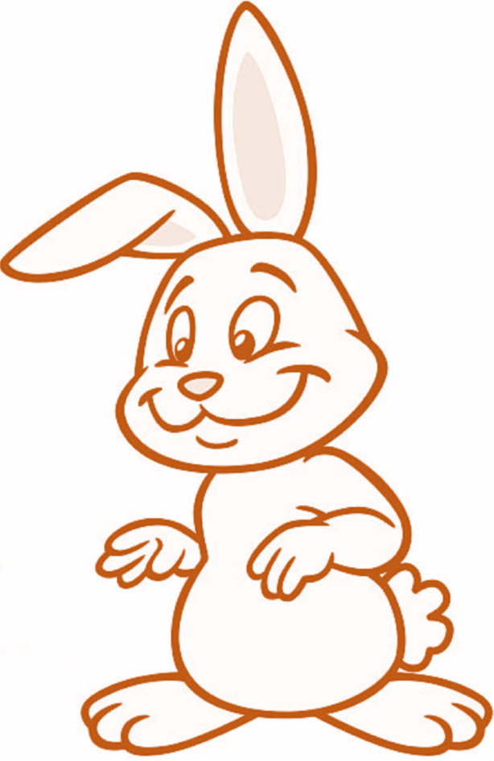

Later in the afternoon, Bunny goes back home. Her/his mom asks how s/he feels about her/his tummy today. Her/his dad asks how s/he feels about her/his foot today.

Slide 7

Here’s where we get to have your help with the story!
You can find out whether Bunny has a tummy ache.
Or, instead, you can find out whether Bunny has sore foot. If you want to find out whether Bunny has a tummy ache please click this; if you want to find out whether Bunny has sore foot please click that.

Slide 8
Bunny has a tummy ache.

Slide 9
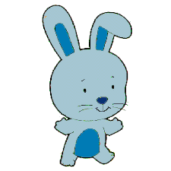
The next day, in the morning, Bunny ran on the grass. Bunny also gave show-and-tell. S/he did very well and everyone clapped! Bunny felt great.
The End
Hurray for Bunny!

Slide 10
Bunny has sore foot.

